Slide 1

Handling Taxes and HST for The Breadboard Bakery
Amany Omar
Date: November 30, 2024

Slide 2
Tracking Annual Sales and Tax Filing System for Victoria’s Growing Bakery
Introduction
Requirements Overview:
Victoria, the owner of The Breadboard Bakery, requested a system to track annual sales to efficiently file HST with the Canada Revenue Agency (CRA).
Condition: Filing required only if sales exceed $30,000 per year.

Slide 3
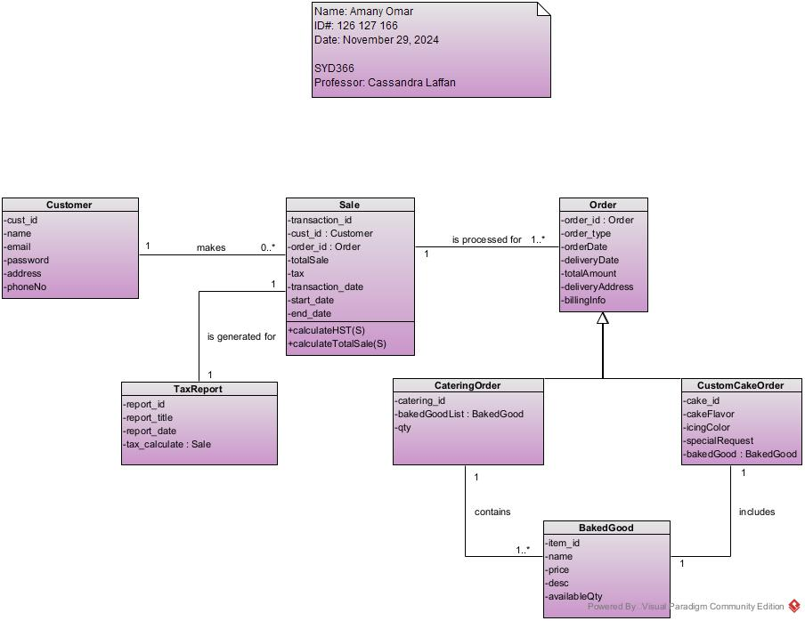
Class Diagram
Purpose: Each class has a specific responsibility that contributes to the HST calculation and report generation.
Sales
Track sales details
E.g. amount, date
Tax
Calculates HST based on sales
TaxReport
Generates tax summary reports

Slide 4
Sequence Diagram
Actor: Owner (Victoria)
Preconditions: Owner is logged in and navigated to Sales Dashboard
Steps:
Select Date Range
Start_date
End_date
System retrieves sales
Calculate total sales amount
Generate Tax Report
Sales below $30,000
Sales exceeds $30,000
“No HST calculation needed”
Calculate HST

Slide 5
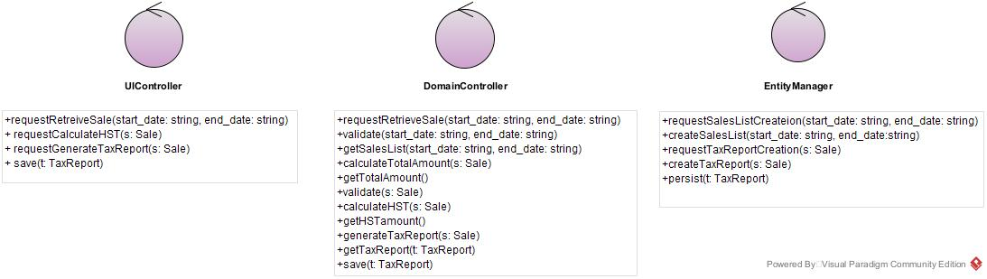
Controller Classes
Purpose:
Ensures a clear separation of responsibilities for smooth functionality.

Slide 6
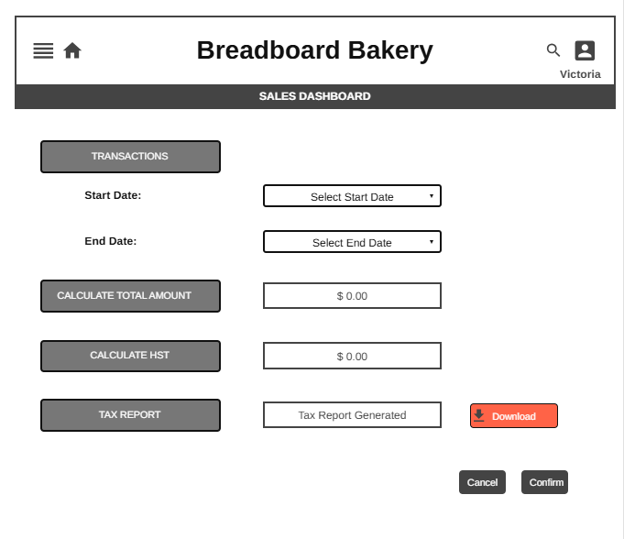

Mock-up

Slide 7


